Slide 1
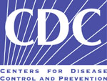
Alcohol: What’s the Problem?
Dan Hungerford, DrPH
Epidemiologist
National Center for Injury Prevention and Control
National Center for Injury Prevention and Control
Centers for Disease Control and Prevention
Notes:
I’m Dan Hungerford, and I’ve worked on alcohol-related issues in emergency departments and trauma centers at CDC’s Injury Center since 1994.

Slide 2
Public Health Model
Define problem
Identify risk & protective factors
Develop & test prevention
strategies
Assure
widespread
adoption
Notes:
You are all familiar with the public health model.
At CDC, we’re always to work toward the right hand side of the model.
We want to implement evidence-based policies and make sure they’re widely adopted in order to have the broadest impact on the public’s health.

Slide 3
Public Health Model
Define problem
Identify risk & protective factors
Develop & test prevention
strategies
Assure
widespread
adoption
Notes:
In the next 15 minutes, I’m going to focus on how we define the fundamental problem alcohol creates in the United States.
I’m focusing on this part of the model because researchers have shifted their definition of the problem.
And most people aren’t aware of this shift.
Until the medical world and the public catch up, we won’t be able to deal with alcohol-related problems adequately.

Slide 4
Spectrum of Use and Misuse
lifetime abstinence
current abstinence
low risk drinking
hazardous drinking
harmful drinking
dependence symptoms
dependence
Notes:
Lifetime abstinence and dependence are the categories we’re already most familiar with. Let me fill in the categories in between the two ends of the spectrum.
Lifetime abstinence: Individuals in this group have never had more than 12 drinks in a year, and never more than weekly or daily maximum limits. (NIAAA definition)
Current abstinence: Although the drinking patterns of individuals in this group are the same as those in the lifetime-abstinence group at the present time, in the past individuals could have been in one of the other categories, even the dependence category. Therefore, the drinking history of individuals in this group is quite heterogeneous.
Low risk drinking: Individuals in this group drink within the recommended limits, which means they may drink regularly but the amount and frequency of their drink is unlikely to lead to harm.
Hazardous drinking: Individuals in this group drink over the recommended limits. Epidemiologic evidence indicates that if they continue to drink at this level, they are at elevated risk for harm related to their drinking.
Harmful drinking: Individuals in this group also drink over the recommended limits. However, they have already experienced harm from their drinking. Their drinking may have fostered a variety of negative consequences—crashing their car, getting into fights, complicating their personal and work relationships, getting into legal trouble, causing health and financial problems. Some of these outcomes are related to drinking too much over a long period of time, such as health problems. These are the chronic outcomes of drinking. Many of the others are related to drinking too much on single occasions, which leads to some level of intoxication and impaired judgment. These are the acute outcomes of drinking.
Dependence symptoms: Individuals in this group experience alcohol dependence symptoms, but no not often enough to warrant a diagnosis of alcohol dependence. Two classic symptoms are 1) being unable to remember what happened the night before the morning after a heavy drinking session and 2) needing a drink to get going the morning after a heavy drinking session.
Dependence: Here is the definition from the International Statistical Classification of Diseases and Related Health Problems 10th Revision (ICD-10).
“A cluster of behavioural, cognitive, and physiological phenomena that develop after repeated substance use and that typically include a strong desire to take the drug, difficulties in controlling its use, persisting in its use despite harmful consequences, a higher priority given to drug use than to other activities and obligations, increased tolerance, and sometimes a physical withdrawal state.” (World Health Organization. The ICD-10 classification of mental and behavioural disorders: clinical descriptions and diagnostic guidelines. Geneva, Switzerland; 1992.)
Here is the definition from the American Psychiatric Association.
Dependence can vary considerably in severity and in accompanying symptoms. But diagnosis requires experiencing three (or more) of the following symptoms within the same 12-month period: 1) tolerance, 2) withdrawal or drinking to relieve withdrawal, 3) impaired control (i.e., persistent desire or unsuccessful attempts to cut down), 4) drinking more or longer than intended, 5) giving up or reducing important activities because of alcohol use, 6) an excessive amount of time spent in obtaining, using, or recovering from the use of alcohol, and 7) continued alcohol use despite recurrent psychological or physical problems. (American Psychiatric Association. Diagnostic and statistical manual of mental disorders, 4th Edition. Washington DC: APA; 1994.)

Slide 5
Alcoholism Model
lifetime abstinence
current abstinence
low risk drinking
96%
hazardous drinking
harmful drinking
dependence symptoms
4%
dependence
Notes:
From the perspective of the Alcoholism Model, this is how the spectrum would look: with the focus on the tip of the iceberg. We’re ignoring most of the population, some of whom clearly could be identified before they become dependent, and before they experience harm

Slide 6
U.S. population
100%
Notes:
It showed that over the last 4 decades we’ve studied how much people in the whole U.S. civilian population drink.
This research asks questions about how much and how often and what kinds of beverages people drink. They also ask about the whole range of negative consequences people experience as a result of their drinking—injuries and problems with health, relationships, jobs, and more.
This research is different from studies of people who are in alcohol treatment. The results give us a picture of how many people are drinking too much and what level of drinking is too much.
Epidemiologic surveys of drinking in the U.S. population started in the 1960s and have continued to the present. These surveys don’t just study alcoholics or an even smaller group—alcoholics who present for specialized treatment. They study the whole population. They ask questions about how much and how often and what kinds of beverages people drink. They also ask about the whole range of negative consequences people experience as a result of their drinking. In this slide each dot represents 1% of the non-institutionalized, civilian population. In the next two slides I’m going to show you the results of the latest epidemiologic surveys in the whole population.
What we found out is that . . .

Slide 7
Alcohol Dependent
< 4%
Notes:
Less than 4% of the population could be diagnosed with alcohol dependence—alcoholism in the common parlance. So, indeed it is a relatively small percentage of the population. Of course, in a big country like this, it’s still a lot of people.
This has been and is still the focus of federal substance abuse programs.
However, the surveys also tell us that

Slide 8
Excessive, Not Dependent
25%
Notes:
25% of the population drinks too much but is not dependent, or alcoholic.
The epidemiology shows that if people keep drinking at this level they are a much higher risk of experiencing a whole range of negative consequences from their drinking: injuries and disease outcomes like car crashes, physical fights, difficulties with colleagues at work and family at home, liver problems, and legal and financial problems. For some, progression to alcohol dependence.

Slide 9
71%
But the data just don’t support that view.
25%
4%
Notes:
So alcohol dependence, or alcoholism, is not the fundamental problem. It’s excessive drinking, which may lead to alcoholism, but for a much larger group of people it leads to harm even though they are not dependent on alcohol.
Notice the red group and the yellow group add up to 29% of the population that drinks too much.
Notice also that there are about 6 times as many people in the yellow group than the red group.
9

Slide 10
lifetime abstinence
71%
current abstinence
low risk drinking
hazardous drinking
25%
harmful drinking
dependence symptoms
4%
dependence
Notes:
We can aggregate the spectrum into three categories. We want the individuals in the green group to keep on doing what they’re doing. We don’t want them to shift into the yellow or red groups. In an SBI program, they’ll get negative screening results. But we want to give them a pat on the back, and probably some bibliotherapy in the form of a pamphlet that tells them how many drinks are too many.
We want those in the yellow group to get a brief intervention. And, the goal of that intervention is to stop drinking or to cut back the amount they drink to stay within reasonable guidelines. We’ll talk about those guidelines in a minute.
For the red group, we want to use the brief intervention to motivate them to get assessed and into specialty treatment. The most common goal for this group is to become and remain abstinent.

Slide 11
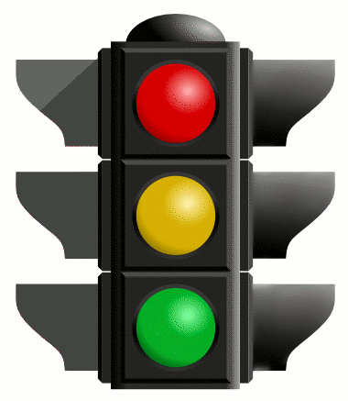
[What is the problem?]
Notes:
Our traditional traffic light is a somewhat more accurate image of the alcohol risks model. It still has a red category to represent the most vulnerable, the alcoholics. It also still has a green category to represent folks who don’t drink or drink so little that it doesn’t cause them harm.
It adds, however, a third color to represent the harm that can come to anyone who drinks too much, but is not addicted.
It’s not a complicated model, but it represents the world of alcohol-related risk much more accurately than a dichotomous model like he two color stop light I showed you earlier.

Slide 12
Screening Threshold
lifetime abstinence
current abstinence
low risk drinking
hazardous drinking
harmful drinking
dependence symptoms
dependence
Notes:
For screening purposes we need a threshold between the green group and the other two groups. This threshold tells us how much is too much.

Slide 13
“Those who choose to drink alcoholic beverages should do so sensibly and in moderation . . .”
U.S. Dietary Guidelines
Men: ≤ 2 per day
Women: ≤ 1 per day
Notes:
The basic rule of thumb is that women should drink, on average, one or fewer drinks per day.
This comes from the Dietary Guidelines for Americans.
It represents a sort of a long-term average for we should strive for.
The problem is that people—in their daily lives—don’t calibrate their behaviors on the basis of a long-term average.
These recommendations are from Dietary Guidelines for Americans.
US Department of Health and Human Services and US Department of Agriculture. Dietary guidelines for Americans, 2005. 6th Edition. Washington DC: US Government Printing Office; January 2005.
Available at http://www.health.gov/dietaryguidelines/dga2005/document/pdf/DGA2005.pdf

Slide 14
Healthy Men ≤ 64
Daily up to 4 drinks
Weekly up to 14 drinks
Notes:
The National Institute on Alcohol Abuse and Alcoholism, one of the National Institutes of Health has done research to devise maximum limits.
Men can drink up to 4 drinks in a day, but no more than 14 in a week.
The reason for a daily and weekly threshold is because alcohol-related problems are either acute or chronic. Explain the two.

Slide 15
Healthy Men ≤ 64
Daily up to 4 drinks
Must meet both limits
Weekly up to 14 drinks
Notes:
Can’t choose one limit or the other. You must meet both. So, if you drink four drinks on Thursday, Friday, and Saturday, you’re only allowed 2 more drinks for the rest of the week to stay under the limit.

Slide 16
Healthy Women & Men ≥ 65
Daily up to 3 drinks
Weekly up to 7 drinks

Slide 17
Healthy Women & Men ≥ 65
Daily up to 3 drinks
Must meet both limits
Weekly up to 7 drinks

Slide 18
What’s the Problem?
excessive drinking
Notes:
Let’s return to the original question:
Alcohol: What’s the problem?
The problem is the harm associated with drinking too much.
And many, many people sometimes drink too much
18

Slide 19
What’s the Problem?
People don’t know
how much is too much.
Not even doctors
Notes:
We can’t address the problems caused by alcohol without doctors and nurses—the whole health care team—understanding the fundamental nature of the problem. We can’t address it on the individual level or the societal level. Even primary prevention programs, like raising taxes on beverage alcohol, require support from members of the health care professions.
The science of how much is too much exists.
We know how much is too much?
It has not been communicated.
To the public
To the health care professions
19

Slide 20
How do you find out if your patients drink too much?
Start asking.
Notes:
Availability of valid self-report screening instruments
That patients in medical setting generally give truthful answers.
That until the medical profession and the general public understand that the fundamental problem is excessive drinking and what is excessive drinking, we won’t be able to make much progress.
The focus on excessive drinking does not leave out alcoholics. No one can become an alcoholic without engaging in excessive drinking. Our emphasis on excessive drinking just broadens our focus so we can engage the alcohol problem earlier.

Slide 21
Parking
Lot

Slide 22
Agent Model
Alcohol Toxic,
Can Harm Anyone
Notes:
From the late 1800s until the first part of the 1900s, the dominant conception of the alcohol problem was what I call the agent model.
Alcohol was considered a toxic molecule.
Anybody who drank alcohol was putting themselves at risk.
It was this widespread, fundamental understanding of the alcohol problem that lead to prohibition.

Slide 23
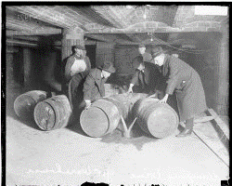
Prohibition (1919 – 1933)
Notes:
In terms of the nation, prohibition lasted from 1919 to 1933.
But prohibitionists had some success even before national prohibition;
in 1905, three American states had already outlawed alcohol;
by 1912, 9 it was up to nine states
by 1916 up to 26 of the 48 states.
1) Nineteenth Amendment to the United States Constitution ratified on January 16, 1919.
2) The "Volstead Act", the popular name for the National Prohibition Act, passed through Congress over President Woodrow Wilson's veto on October 28, 1919 and established the legal definition of intoxicating liquor.^{[1]}
3) Nineteenth Amendment went into effect January 16, 1920.
4) On March 22, 1933, President Franklin Roosevelt signed into law an amendment to the Volstead Act known as the Cullen-Harrison Act, allowing the manufacture and sale of certain kinds of alcoholic beverages.
5) On December 5, 1933, the ratification of the Twenty-first Amendment repealed the Eighteenth Amendment.
Wiki:
Prohibition agents destroying barrels of alcohol.
Began January 16, 1920 when the Eighteenth Amendment went into effect
Abolished on February 17, 1933 by passage of the Blaine Act, which amended the Volstead Act allow "3.2 beer" (3.2 percent alcohol by volume).
The Eighteenth Amendment was repealed later in 1933 with ratification of the Twenty-first Amendment on December 5.
The Twenty-first Amendment, which repealed nationwide prohibition, explicitly gives states the right to restrict or ban the purchase and sale of alcohol;
The Twenty-first Amendment, which repealed nationwide prohibition, explicitly gives states the right to restrict or ban the purchase and sale of alcohol; this has led to a patchwork of laws, in which alcohol may be legally sold in some but not all towns or counties within a particular state. After the repeal of the national constitutional amendment, some states continued to enforce prohibition laws; Oklahoma, Kansas, and Mississippi were still "dry" in 1948. Mississippi, which had made alcohol illegal in 1907, was the last state to repeal prohibition, in 1966.

Slide 24
Alcoholism Model
Some individuals uniquely vulnerable to alcohol

Slide 25
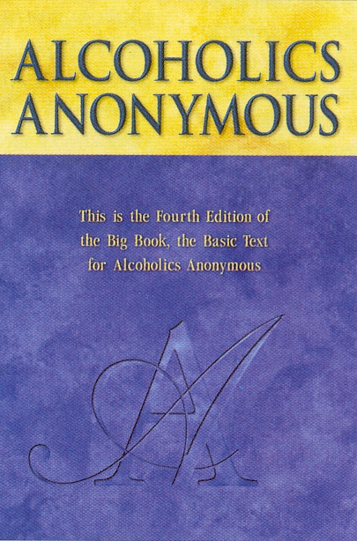
Notes:
Alcoholics Anonymous started in 1935 and popularized the idea of alcoholism. It also motivated research that ultimately led to alcoholism being considered a disease—both in the medical world and by society at large. The underlying idea is that certain individuals are uniquely vulnerable to alcohol. And, Alcoholics Anonymous maintains that alcoholics must remain abstinent in order to avoid further problems. It’s not a bad model. At least, as far as it goes. The main problem with the alcoholism model is that it ignores a fundamental reality. Alcohol is a toxic substance for anyone who consumes too much.

Slide 26
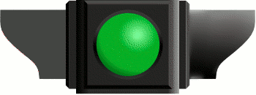
Alcoholism Model
Notes:
Exclusive focus on the most vulnerable creates a dichotomous model that’s misleading. Like this stoplight, it’s a model with only two categories. Red represents the group that’s vulnerable and likely to become alcoholic. And green represents the rest of the population which is presumably not vulnerable.
It’s not that the colors are wrong. The problem is that it promotes a misleading mindset. That is, if you’re an alcoholic, you shouldn’t drink at all. If you’re not, you don’t really need to worry about alcohol. You’re not a member of that vulnerable group. It ignores the fact that alcohol is dangerous to anyone who drinks too much, whether they’re an alcoholic, likely to become an alcoholic, or not.
Even if you’ve never drunk any alcohol in your life, if you drink too much the first time, you’re at risk.

Slide 27
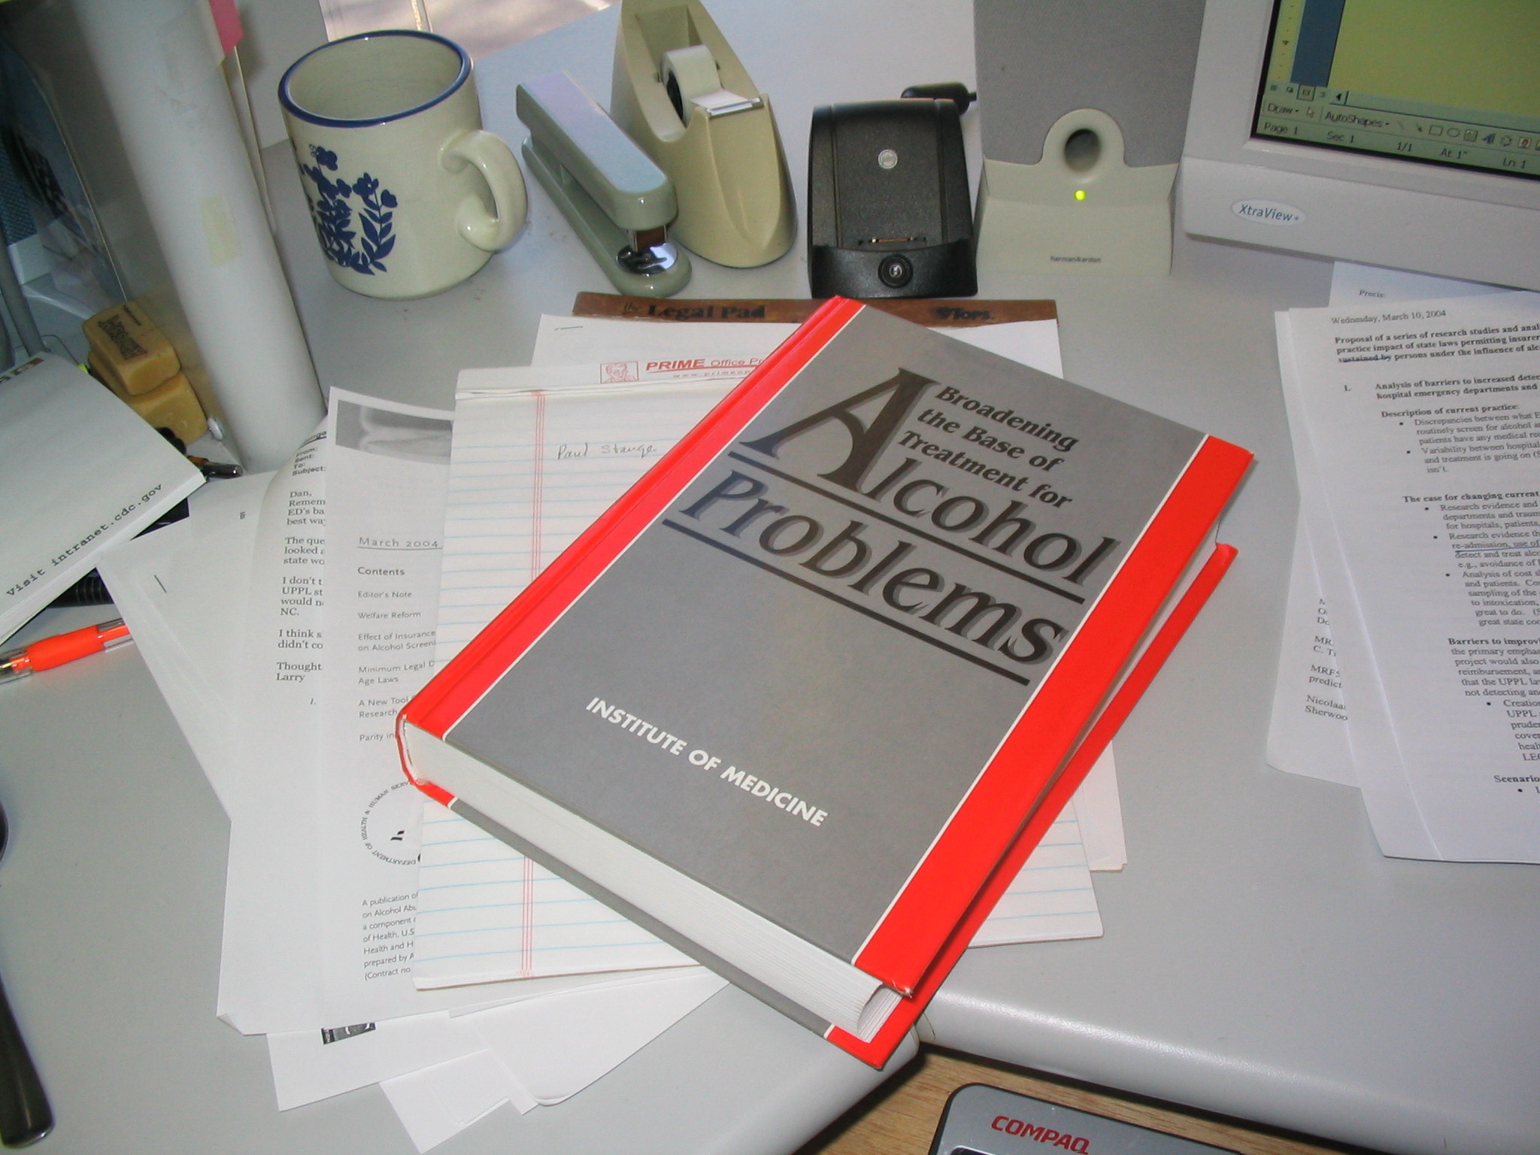
1990
Notes:
By 1990, the research was strong enough for the IOM to publish a book entitled Broadening the Base of Treatment of Alcohol Problems.
It summarized the research to date and based its recommendations on epidemiologic research.

Slide 28
epidemiologic
shift
The ecology of medical care
White KL, Williams F, Greenberg BG 1961 NEJM 265(18): 885-892.
Notes:
Enter the epi shift. In 1961, Kerr White published study describing the “epidemiologic shift.”
He showed that to understand a disease we need to study the whole population, not just the people who show up for treatment.
Up to this point in time, we had only studied people who came to hospitals, which it turns out, produces a very biased sample.
In the 1960s epidemiologists began study drinking in the whole population. And they discovered a whole spectrum of use and misuse.

